Slide 1

CCPS 305
Recursion

Slide 2
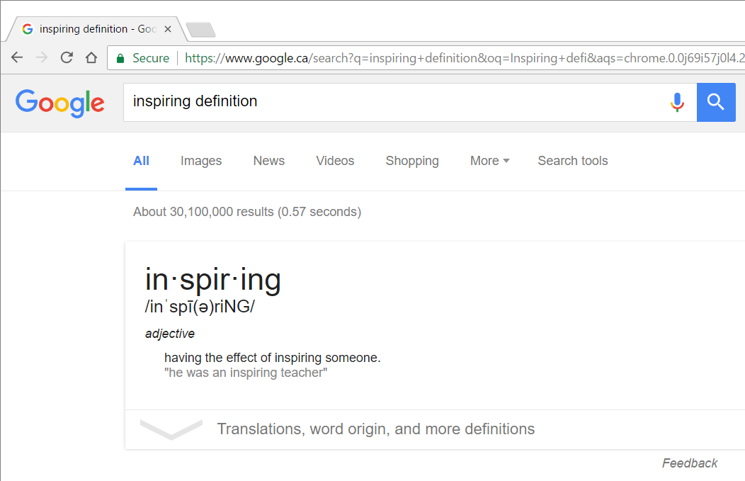
Recursion

Slide 3
Recursive Acronym
GNU
Stands for
“GNU is not Unix”

Slide 4
Recursion – Computer Science
When algorithm uses recursion – a function is called over and over (by itself or other functions)
Recursive function call – when a calls itself
Mutually Recursive – A -> B -> A… (Can involve any number of functions)

Slide 5

Rules of Recursion
Contains recursive case
Contains base case
Make progress towards base case

Slide 6

Rules of Recursion
Contains recursive case
Contains base case
Make progress towards base case

Slide 7
Rules of Recursion
Contains recursive case
Contains base case
Make progress towards base case

Slide 8
Recursion Example
Given List-ADT operations:
first (L) : returns 1st item on List L
rest(L) : returns L with 1st item removed
empty(L) : true if L is empty
Sum3(x)
if empty(x) return 0
else return (first(x) + Sum3(rest(x))
Base Case- The way out!
Recursive Case
Progress

Slide 9
Recall:
Sum3(x)
if empty(x) return 0
else return (first(x) + Sum3(rest(x))
Call Trace
Call trace of Sum3(1, 2, 3):
Sum3(1, 2, 3)
= (1+Sum3(2,3))
= (1+(2+Sum3(3)))
= (1+(2+(3+Sum3(<>))))
= (1+(2+(3+0)))
= (1+(2+3))
= (1+5)
= 6

Slide 10

Divide and Conquer
Algorithms

Slide 11
Divide and Conquer Algorithm
Solve an N size problem by dividing it into small/similar type problems
Continue to divide until the problem is small enough to conquer
Solve N size problem by combining the conquered smaller problems

Slide 12
Down-by-1 D&C
One smaller problem is size 1
Other one is size n-1
Division-in-halves D&C
D&C works better if smaller problems if each size is ~n/2

Slide 13
Call Trace
Call trace of Sum3(1,2,3,4,5,6,7,8):
Sum3(1,2,3,4,5,6,7,8)
= (1+Sum3(2,3,4,5,6,7,8))
= (1+(2+Sum3(3,4,5,6,7,8)))
= (1+(2+(3+Sum3(4,5,6,7,8))))
= (1+(2+(3+(4+Sum3(5,6,7,8)))))
= (1+(2+(3+(4+(5+Sum3(6,7,8))))))
= (1+(2+(3+(4+(5+(6+Sum3(7,8)))))))
= (1+(2+(3+(4+(5+(6+(7+Sum3(8))))))))
= (1+(2+(3+(4+(5+(6+(7+(8+Sum3(<>)))))))))
= (1+(2+(3+(4+(5+(6+(7+(8+0))))))))
= (1+(2+(3+(4+(5+(6+(7+8)))))))
= (1+(2+(3+(4+(5+(6+15))))))
= (1+(2+(3+(4+(5+21)))))
= (1+(2+(3+(4+26))))
= (1+(2+(3+30)))
= (1+(2+33))
= (1+35)
= 36
Phew 17 ‘lines’

Slide 14
Define Sum4
Given List-ADT operations:
firstHalf(L) : returns 1st half of List L
lastHalf(L) : returns last half of List L
singleItem(L) : true if length(L) == 1
firstItem(L) : returns 1st item of L
Sum4(x)
if empty(x) return 0
if singleItem(x) return firstItem(x)
else return (Sum4(firstHalf(x))+
Sum4(lastHalf(x))

Slide 15
Recall:
Sum4(x)
if empty(x) return 0
if singleItem(x) return firstItem(x)
else return (Sum4(firstHalf(x))+
Sum4(lastHalf(x))
Call Trace
Sum4(1,2,3,4,5,6,7,8)
= (Sum4(1,2,3,4)+sum4(5,6,7,8))
= (Sum4(1,2)+Sum4(3,4))+(Sum4(5,6)+Sum4(7,8))
= (((Sum(1)+Sum(2))+(Sum4(3)+Sum4(4)))) + (((Sum4(5)+Sum4(6))+(Sum4(7)+Sum4(8)))
= ((1+2)+(3+4))+((5+6)+(7+8))
= (3+7)+(11+15)
= (10+26)
= 36
7 ‘lines’
Compare to
Sum3’s 17 lines

Slide 16
Going-up Recursion
D&C by reducing problem size by i (i >= 1) each time such that argument to recursive function goes up each time
Example:
SumU(A, x, y)
if x < y return A[x] + SumU(A,x+1,y)
else if x == y return A[x]
else return 0

Slide 17
Going-down Recursion
D&C by reducing problem size by i (i >= 1) each time such that argument to recursive function goes down each time
Example:
SumD(A, x, y)
if x < y return A[x] + SumD(A,x,y-1)
else if x == y return A[x]
else return 0

Slide 18
Edges & Center Recursion
SumE(L, x, y)
if x<y return L[x] + L[y] + SumE(L, x+1, y-1)
if x == y return L[x]
else return 0
Call Trace
SumE(L, 1, 5), L=1,2,3,4,5,6,7
SumE(L,1,5)
= (2+6+SumE(L,2,4))
= (2+6+(3+5+SumE(L,3,3)))
= (2+6+(3+5+4))
= (2+6+(12))
= 20
Try SumE(L,1, 4)
See why last base case is important

Slide 19
Find an Edges & Center Recursion solution for reversing n items on List L
reverseList(L, x, y)
Call Trace reverseList(<1,2,3,4,5>, 0, 4)
reverseList(L, x, y)
if x<y
swap(L, x, y)
revrseList(L, x+1, y-1)
Call Trace
reverseList(<1,2,3,4,5>,0,4)
reverseList(<5,2,3,4,1>,1,3)
reverseList(<5,4,3,2,1>,2,2)
Where swap(L, x, y) swaps items at indexes x & y List L

Slide 20
Last and All but Last
reverseList(L,)
if empty(L) return L
else return (concat(Last(L), reverseList(firstPart(L)))
First and All but First (Rest)
reverseList(L,)
if empty(L) return L
else return (concat(reverseList(lastPart(L)),
First(L))

Slide 21
Call Tree
Recall:
Sum4(x)
if empty(x) return 0
if singleItem(x) return firstItem(x)
else return (Sum4(firstHalf(x))+ Sum4(lastHalf(x))
Sum4(1,2,3,4,5,6,7,8)
/ \
Sum4(1,2,3,4) Sum4(5,6,7,8))
/ \ / \
Sum4(1,2) Sum4(3,4) Sum4(5,6) Sum4(7,8)
/ \ / \ / \ / \
Sum4(1) Sum4(2) Sum4(3) Sum4(4) Sum4(5) Sum4(6) Sum4(7) Sum4(8)
What Kind of D&C?

Slide 22
Call Chain
Recall:
SumU(A, x, y)
if x < y return A[x] + SumU(A,x+1,y)
else if x == y return A[x]
else return 0
What Kind of D&C?
A=1,2,3,4,5,6,7,8
SumU(A, 1, 8)
|
SumU(A, 2, 8)
|
SumU(A, 3, 8)
|
SumU(A, 4, 8)
SumU(A, 5, 8)
|
SumU(A, 6, 8)
|
SumU(A, 7, 8)
|
SumU(A, 8, 8)

Slide 23
Annotated Call Tree
Recall:
SumE(L, x, y)
if x<y return L[x] + L[y] + SumE(L, x+1, y-1)
if x == y return L[x]
else return 0
[42]
[3]+[9]+ [30]
[4]+[8] + [18]
[5]+[7] + [6]
[6]
SumE(A, 3, 9)
|
SumE(A, 4, 8)
|
SumE(A, 5, 7)
|
SumE(A, 6, 6)

Slide 24
Annotated Call Tree
Sum4(1,2,3,4)
/ \
Sum4(1,2) Sum4(3,4)
/ \ / \
Sum4(1) Sum4(2) Sum4(3) Sum4(4)
| | | |
[10]
[3] [7]
[1] [2] [3] [4]
[1] [2] [3] [4]

Slide 25
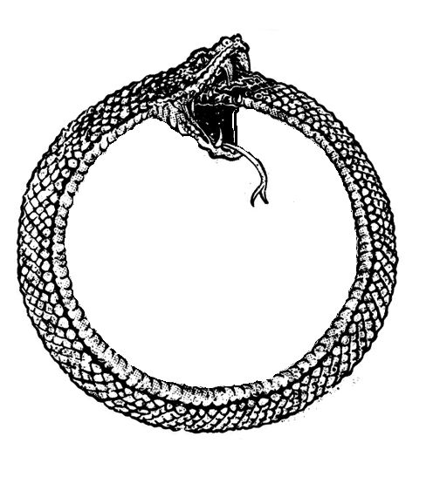
Tail Recursion

Slide 26
Call trace of Sum3(1,2,3,4,5,6,7,8):
Sum3(1,2,3,4,5,6,7,8)
= (1+Sum3(2,3,4,5,6,7,8))
= (1+(2+Sum3(3,4,5,6,7,8)))
= (1+(2+(3+Sum3(4,5,6,7,8))))
= (1+(2+(3+(4+Sum3(5,6,7,8)))))
= (1+(2+(3+(4+(5+Sum3(6,7,8))))))
= (1+(2+(3+(4+(5+(6+Sum3(7,8)))))))
= (1+(2+(3+(4+(5+(6+(7+Sum3(8))))))))
= (1+(2+(3+(4+(5+(6+(7+(8+Sum3(<>)))))))))
= (1+(2+(3+(4+(5+(6+(7+(8+0))))))))
= (1+(2+(3+(4+(5+(6+(7+8)))))))
= (1+(2+(3+(4+(5+(6+15))))))
= (1+(2+(3+(4+(5+21)))))
= (1+(2+(3+(4+26))))
= (1+(2+(3+30)))
= (1+(2+33))
= (1+35)
= 36
Simple recursion implementations balloon the stack as the nesting gets deeper and deeper
Waste!

Slide 27
Tail Recursion
A function call is said to be tail recursive if there is nothing to do after the function returns except return its value
When last executed operation (recursive case) in a function is a recursive call to the function Note: “last executed” may not be last line in code
Can be optimized by some compilers

Slide 28
Consider recursive definition of factorial
factorial(n)
if n == 1 return 1
return n * factorial(n - 1)
Not tail-recursive!
Tail recursion of factorial
factorial1(n, accumulator)
if n == 1 return accumulator
return factorial1(n - 1, n * accumulator)
factorial(n)
return factorial1(n, 1)

Slide 29
More examples
P(L, x)
if x > 0
Print L[x]
return P(L, x-1)
else
return 0
ReverseString (S, m, n) reverses characters in substring [m-n] of S
ReverseString(S, m, n)
if m < n
swap(S, m, n)
return ReverseString(S, m+1, n-1)
Last executed in
recursive case

Slide 30
Mutual vs Self Tail Recursion
ReverseString is Self-Tail Recursive – It calls itself
Mutual-Tail Recursive happens when A calls B, B calls A
(Any number of functions may be involved)

Slide 31
Pop Quiz
P(x)
if x > 0 return x+P(x-1)
else return 0
Is this tail recursive?
NO

Slide 32
Compilers and Recursion
Some languages don’t allow recursion
Most do – e.g. Java, R, Python
Some facilitate recursion – e.g. Lisp, Scheme

Slide 33
Compilers and Recursion
When a function called, a STACK FRAME is pushed on run-time stack
Run-time stack keeps info such as:
Address to return to
Memory for permissions and function variables
Memory for function return value
The deeper the recursion, the bigger the Run-time stack
Stack size -> Space
Stack overhead -> Long time to run

Slide 34
Optimize recursion if possible
GCC, some JVMs, Scala optimize self-tail recursion but can’t do mutual-tail recursion
All functional languages (Lisp, Scheme, Haskell) optimize both S.T.R and M.T.R
How?
Compilers cam clobber (mostly) previous stack frame with new one – so stack doesn’t grow
Some do not optimize at all (R, Python)

Slide 35
How can we remove recursion?
Iterations:
At each step, update a partial solution (typically by iteration over a variable (i). The partial solution gets close and closer to the final solution at each step.
ALL recursion can be redefine as iteration
Tail recursion is “easy”

Slide 36
Infinite Regress
NOT GOOD
Recursion never ends
Could be programmer’s or user’s fault
Why?
Forget base case
Incomplete base cases
Never hits base case
Programmer’s error
User doesn’t pay attention to API (factorial example)
Not enough resources(memory, computational power)

Slide 37
How do you know when to use Recursion?
Depth of recursive calls is relatively shallow – e.g. divide and conquer division in ½ is good
Recursive and non-recursive do about the same amount of work
Recursive version is much simpler

Slide 38
Common uses for Recursion
Defining things – e.g. Context Free Grammar
Generating things – e.g. Recursive algorithm to generate Context Free Language
Recognizing things – e.g. Recursive descent parser to tell whether a string belongs to the language
Proving things – e.g. Recursion Induction

Slide 39

Tower of Hanoi

Slide 40
Tower of Hanoi – Background
Puzzle invented by mathematician Edward Lucas in 1883
AKA Tower of Brahma, Lucas’ Tower
Legend:
In Brahma, a temple with a dome marking center of the world
God placed 3 posts made of diamonds and 64 golden disks
Priests move disk from 1st to last posts according to “immutable rules”
When they finish, the universe comes to an end

Slide 41
Tower of Hanoi – Rules
Can only move 1 disk at a time
No larger disk can be placed on a smaller disk

Slide 42
Tower of Hanoi – Extras
We will see later that it takes at least 2⁶⁴ – 1 moves to finish
At 1 move per second, this takes 585 Billion years
Or 18,446,744,073,709,551,615 turns to finish
Or about 42 times the current age of the Universe
Demo: http://www.dynamicdrive.com/dynamicindex12/towerhanoi.htm

Slide 43

Tower of Hanoi – Algorithms
FUNCTION MoveTower(N, start, finish, temp):
IF disk == 1
print “move disk from” start “to” finish
ELSE
MoveTower(N - 1, start, temp, finish) print “move disk from” start “to” finish
MoveTower(N - 1, temp, finish, start)

Slide 44
Questions?

